Slide 1
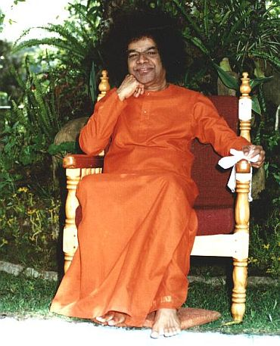
Generalizable Facial Expression Recognition
Aum Sri Sai Ram
Presented by:
Sai Narendra
Supervised By:
Prof. SVSN Sarma, Asst. Professor, Mathematics & Computer Science, SSSIHL
Dr. Darshan Gera, Asst. Professor, Mathematics & Computer Science, SSSIHL

Slide 2
Table of contents:
Problem Statement
Introduction
Literature View
Methodology
Implementation Details
Results
Conclusion
Future Work
2

Slide 3
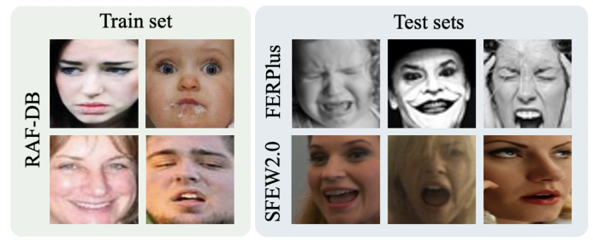
Problem statement:
Facial Expression Recognition (FER) models struggle to generalize across different datasets due to domain gaps. (e.g., different lighting, ethnicities, camera qualities, or facial features).
Existing domain adaptation techniques require labelled or unlabelled target domain samples for fine-tuning, which is often impractical.
Zero-Shot Generalization → The goal is to train on one dataset and generalize well to unseen test sets without additional adaptation.
Referenced Paper :
Zhang, Yuhang, et al. "Generalizable Facial Expression Recognition." European Conference on Computer Vision. Cham: Springer Nature Switzerland, 2024.
3

Slide 4
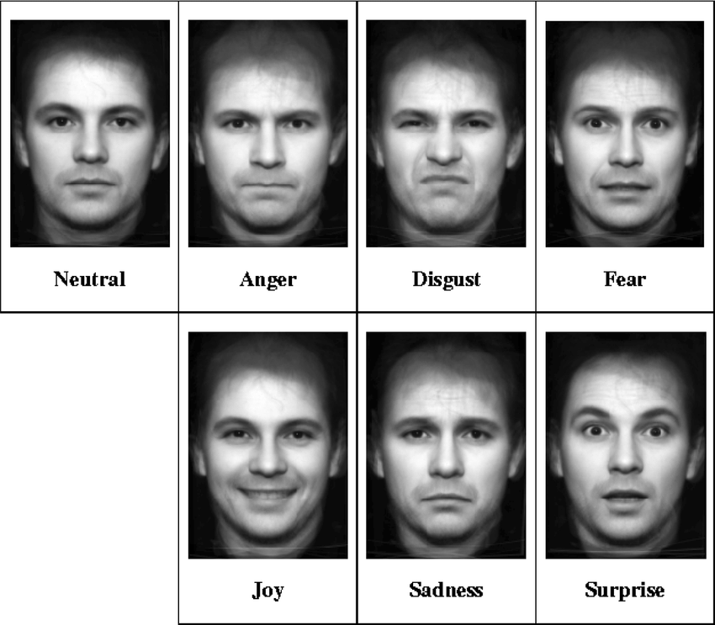
Introduction:
Facial expression recognition plays a critical role in human-computer interaction.
Despite the success of deep learning-based FER models, they exhibit poor generalization when tested on unseen datasets with domain shifts.
Current domain adaptation approaches assume access to target domain data, which is not feasible in real-world scenarios.
4

Slide 5
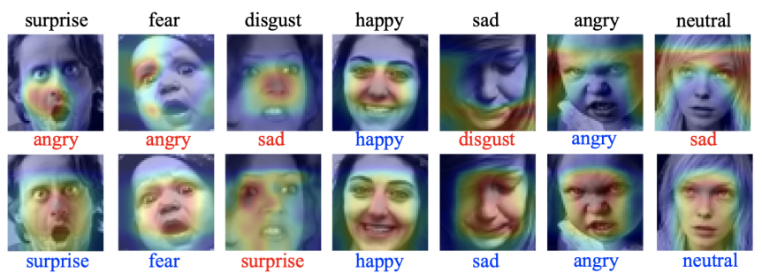
Key Challenges in FER:
Domain Shift Problem
Data Dependency
Zero-Shot Generalization
5

Slide 6
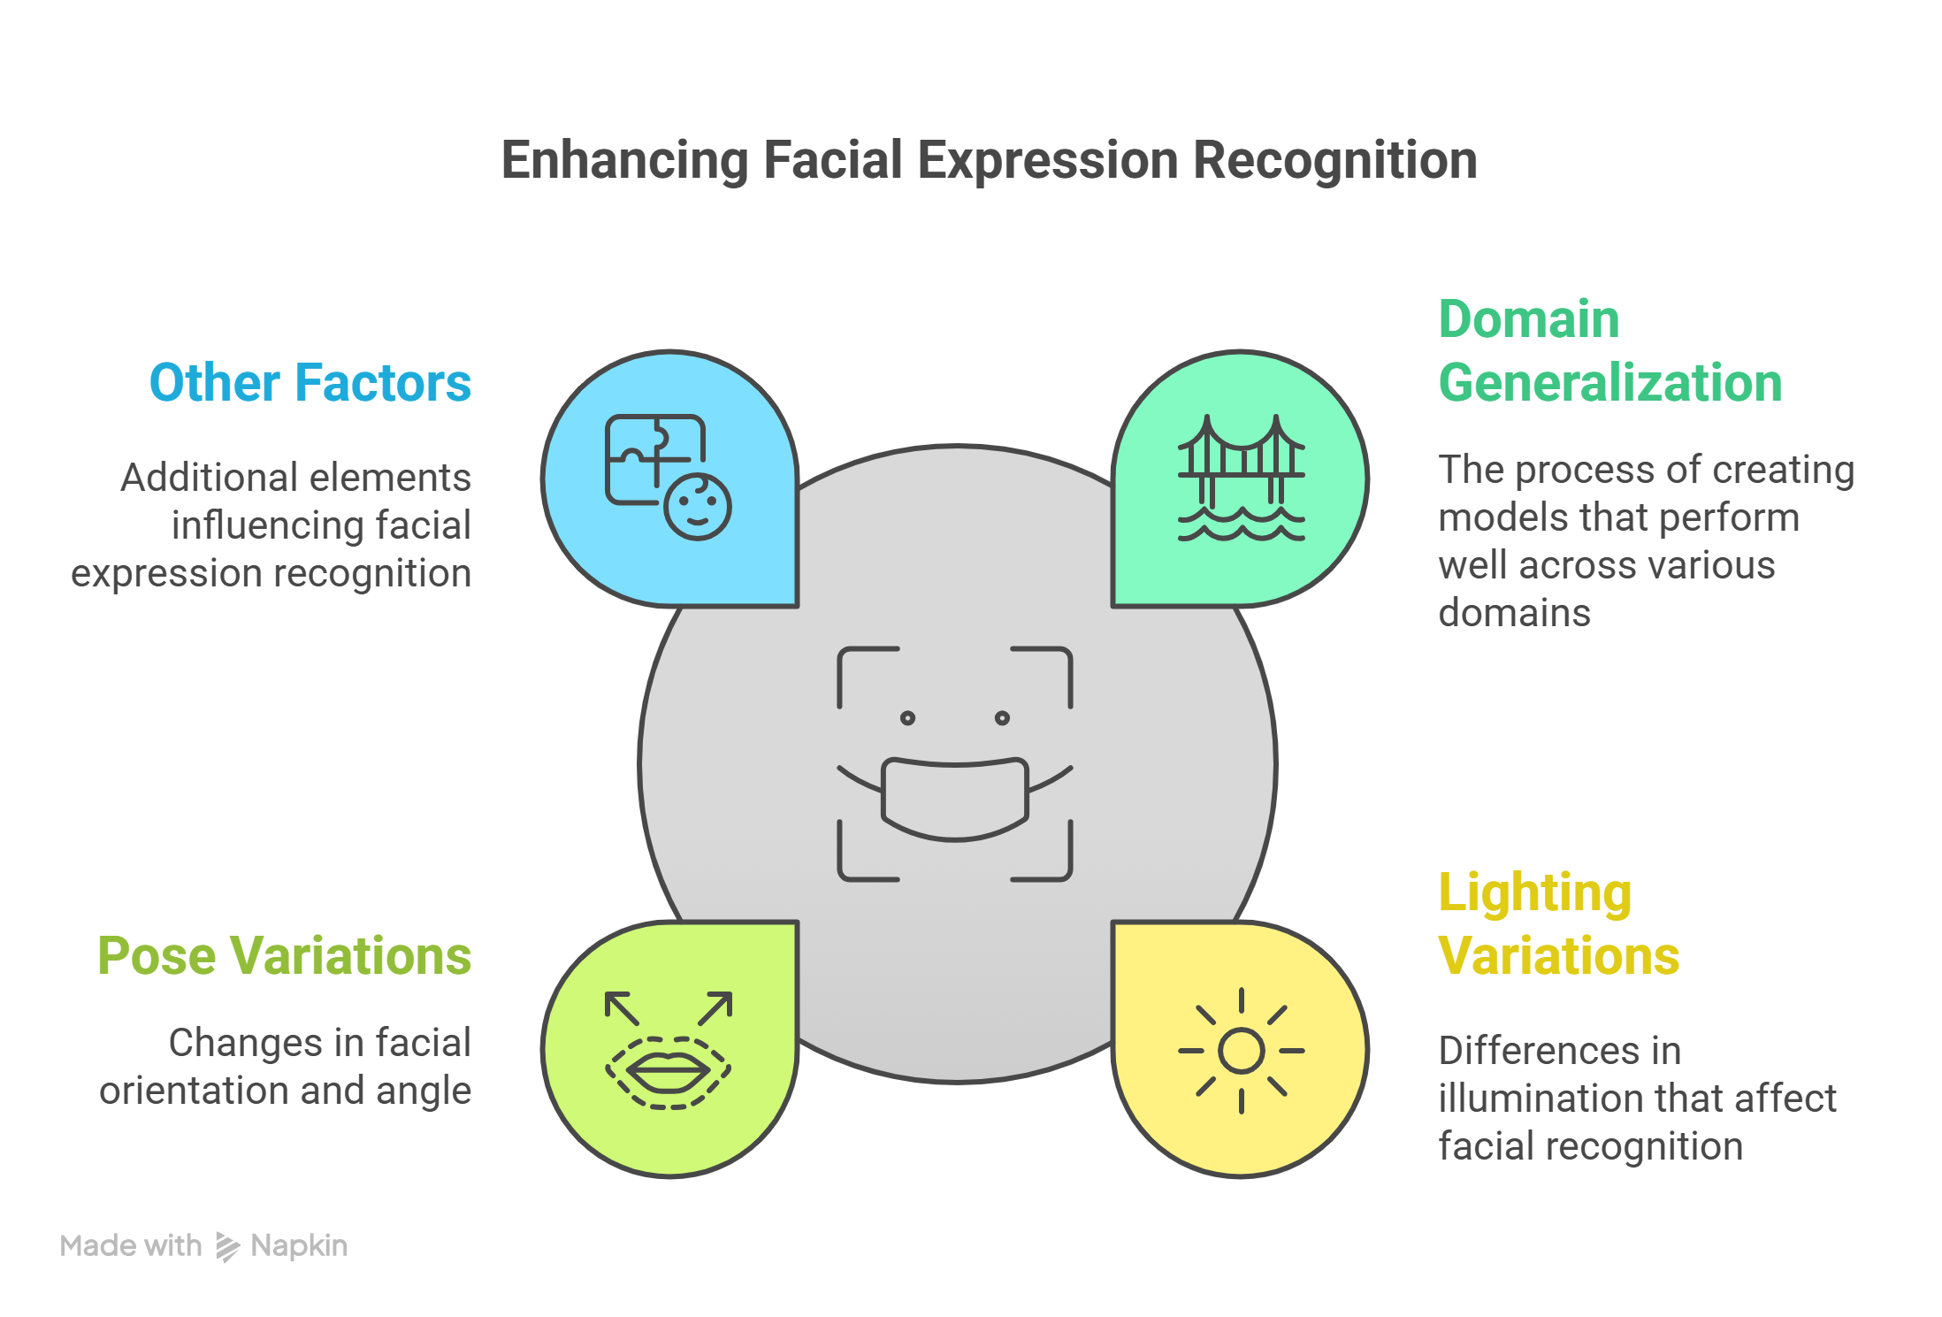
Literature View:
Facial Expression Recognition (FER)
Domain Generalization (DG)
Pre-trained Feature Extractors
6

Slide 7
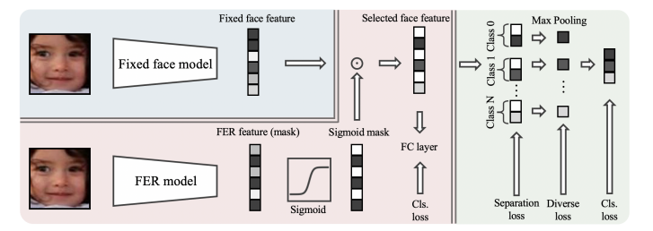
Methodology:
Detect Faces First, Then Extract Expression Features
Feature Extraction : Uses a fixed pre-trained model (CLIP) to extract face features, ensuring domain generalization.
Mask Learning : Sigmoid Mask Learning on CLIP Features
Channel Separation : Avoids fully connected layers by dividing features into seven expression classes.
Channel-Diverse Loss for Better Feature Separation
7

Slide 8
Implementation :
Model Architecture :
Backbone Model: ResNet-18
Feature Extraction Model: CLIP VIT-B/32 (Vision Transformer)
Training Configuration & Hyperparameters
Optimizer : Adam
Weight decay = 0.0001
Learning Rate & Scheduler :
Initial Learning Rate (η) = 0.0002
Scheduler: ExponentialLR : Gamma = 0.9
Loss Function Weights :
Channel-wise loss weight = 1.5
Diversity loss weight = 5
9

Slide 9
Framework:
Step 1:
The input image is augmented by adding Gaussian noise and applying horizontal flipping to enhance the model's robustness.
Step 2:
The image is passed through the CLIP model, which uses a Vision Transformer (ViT) to extract high-level semantic features. These features are stored in a vector referred to as x.
Step 3:
In parallel, the same image is also passed through a ResNet-18 model up to its second-last layer (typically the pooling layer). The output is then flattened to prepare it for further processing.
Step 4:
A sigmoid activation is applied to the ResNet output to generate a soft mask. This mask is then applied element-wise to the CLIP features by multiplying the two vectors.
Step 5:
Finally, the masked CLIP features are passed through a fully connected (FC) layer to produce the final classification output.
This approach effectively combines the localized visual features from ResNet and the semantic-rich features from CLIP to make accurate predictions.
10

Slide 10
Losses used :
Classification Loss (Cls. loss):
Compares the predicted class with the true label
Usually done using crossentropyloss
Seperation loss:
Calculated by comparing features across different classes in the batch.
Encourages features from different classes to be more distinct.
Helps reduce overlap in feature space.
Diverse Loss:
Encourages different neurons (dimensions) to capture different aspects of the data.
Promotes feature diversity, so the model doesn’t overly rely on just a few dimensions.
At last all loses are added and used to perform backpropogation and update the trainable parameters.
11

Slide 11
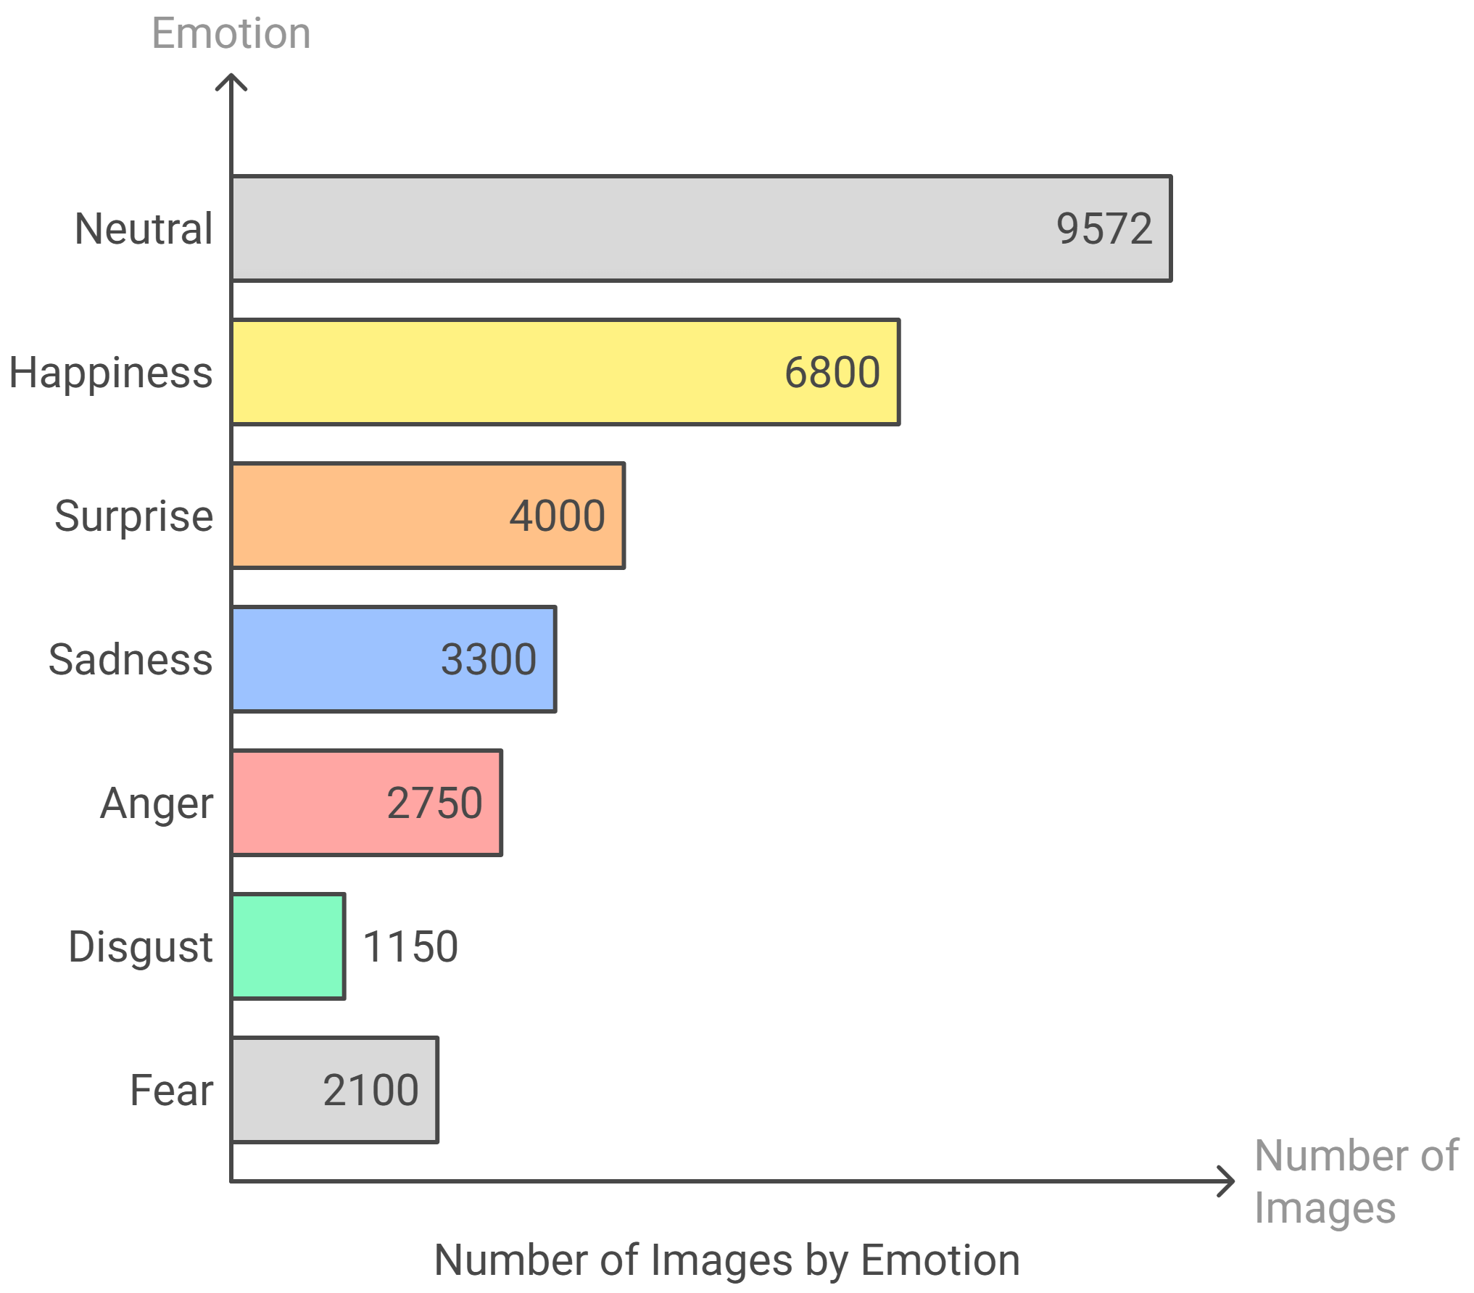
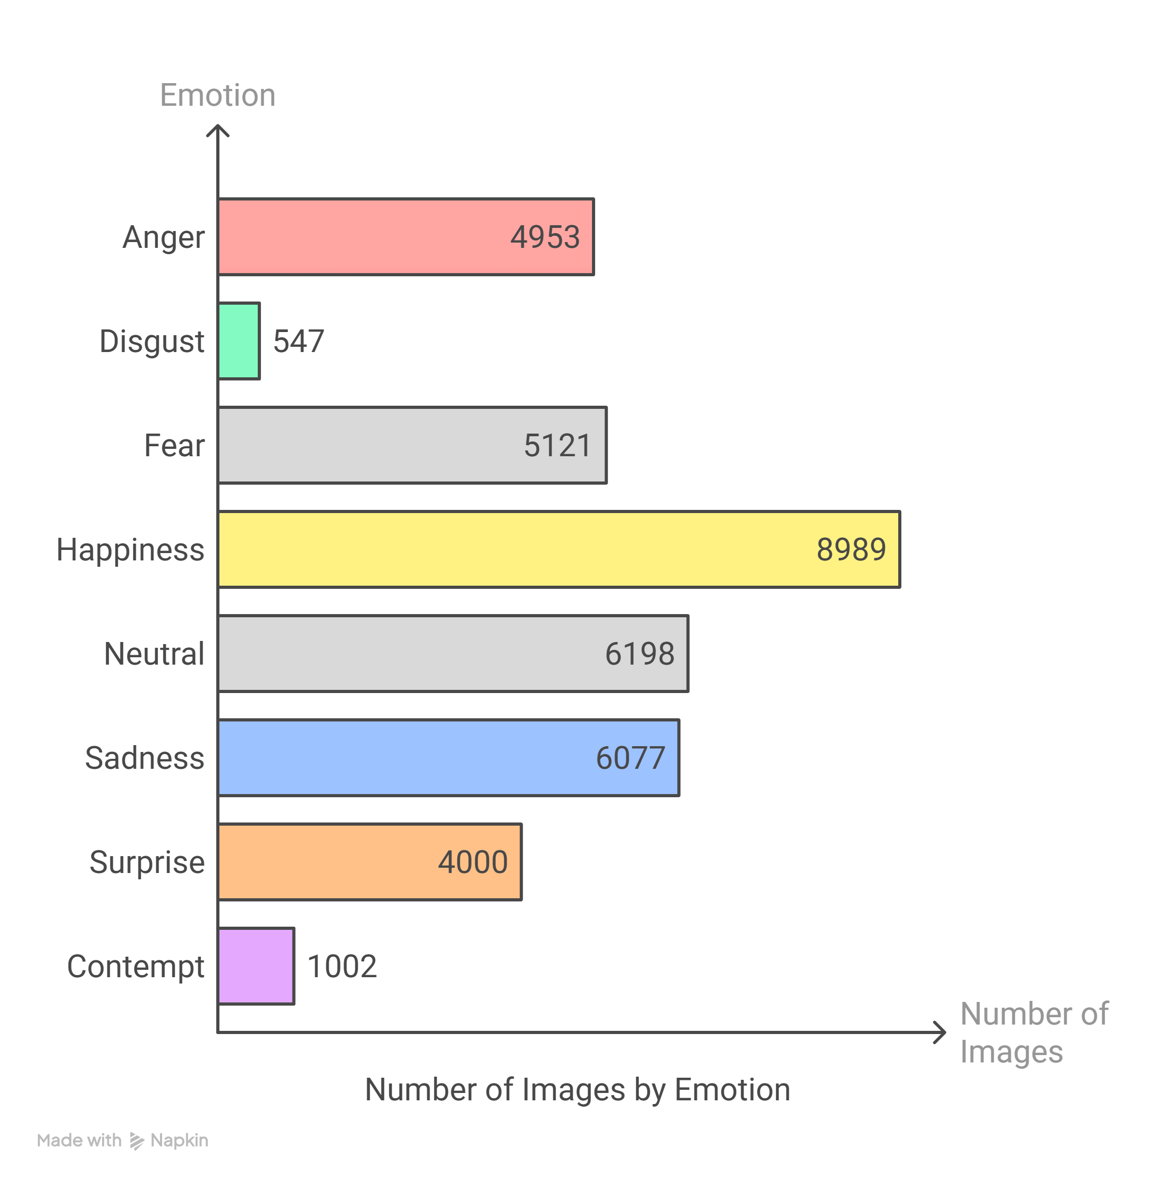
Datasets :
Li, Shan, and Weihong Deng. "Reliable crowdsourcing and deep locality-preserving learning for unconstrained facial expression recognition." IEEE Transactions on Image Processing, vol. 28, no. 1, 2019, pp. 356–370.
I used RAF-DB Dataset for training and tested on RAF-DB and FERPlus datasets.
I used FERPlus dataset for training and tested on RAF-DB and FERPlus datasets.
8

Slide 12
Results:
Training Dataset | Testing Dataset | Accuracy | Our Accuracy
RAF-DB | RAF-DB | 88.72 | 84.29
FERPlus | FERPlus | 89.51 | 86.83
RAF-DB | FERPlus | 73.16 | 86.20
FERPlus | RAF-DB | 72.91 | 85.04
12

Slide 13
Performance of our method under different backbones:
Backbone | RAF-DB | FERPlus | Affect Net | SFEW2.0 | MMA | Mean
MobileNet | 84.65 | 61.33 | 43.45 | 43.21 | 40.67 | 54.66
MobileNet+our | 85.07 | 64.97 | 42.91 | 45.45 | 43.11 | 56.30
Resnet-18 | 88.40 | 58.05 | 43.25 | 42.76 | 42.61 | 55.01
Resnet-18+our | 88.72 | 73.16 | 45.86 | 52.86 | 56,80 | 63.48
Resnet-50 | 88.49 | 70.13 | 47.46 | 49.94 | 48.90 | 60.98
Resnet-50+our | 89.05 | 75.26 | 47.49 | 51.07 | 57.46 | 64.07
13

Slide 14
Conclusion:
I have implemented a generalizable FER method that significantly improves zero-shot performance across different datasets.
By leveraging pre-trained models and selective feature masking, the model avoids overfitting and adapts better to unseen domains.
14

Slide 15
Future Work:
Exploring different pre-trained models for better feature extraction.
Dino, ArgFace, GGFace
Extending the approach to multi-label or compound expressions.
Investigating more robust loss functions to further improve generalization.
Constrative loss
15

Slide 16
Acknowledgements:
Sri SVSN . Sarma
Assistant Professor, DMACS, Nandigiri Campus
Sri Darshan Gera
Assistant Professor, DMACS, Prashanthi Nilayam Campus, SSSIHL
16

Slide 17
References:
Zhang, Yuhang, et al. "Generalizable Facial Expression Recognition." European Conference on Computer Vision. Cham: Springer Nature Switzerland, 2024.
PyTorch Tutorials. Custom Dataset and DataLoaders Tutorial
“https://pytorch.org/tutorials/beginner/data_loading_tutorial.html”.
Medium Article “https://medium.com/analytics-vidhya/creating-a-custom-dataset-and-dataloader-in-pytorch-76f210a1df5d”.
Coursera course “https://www.coursera.org/learn/convolutional-neural-networks/home”.
17

Slide 18
CURRENT WORK
Jugular Vein Detection
collecting dataset
training on model
testing
2. Pupil reflex
fitting ellipse to the pupil
16

Slide 19
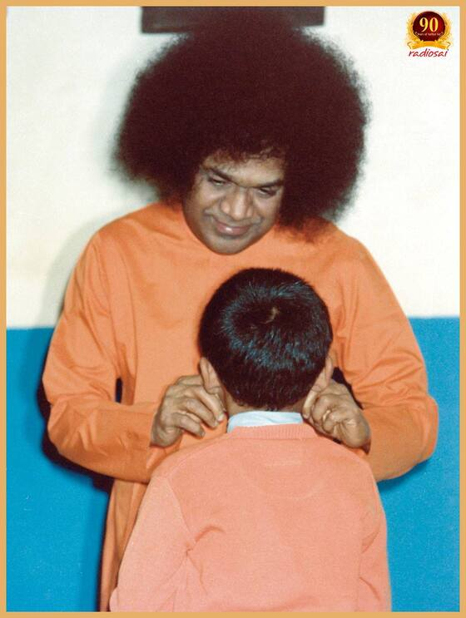
Thank you! Jai sairam
18

